Slide 1
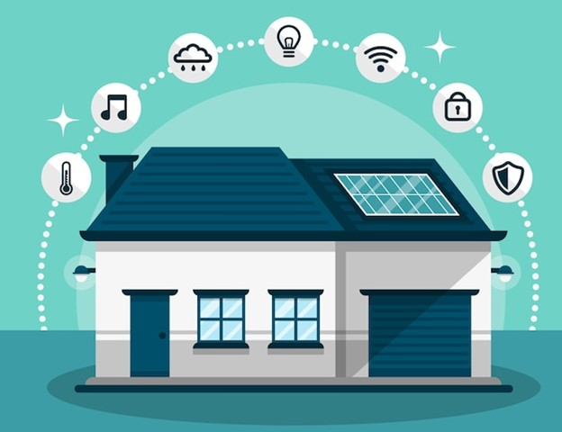
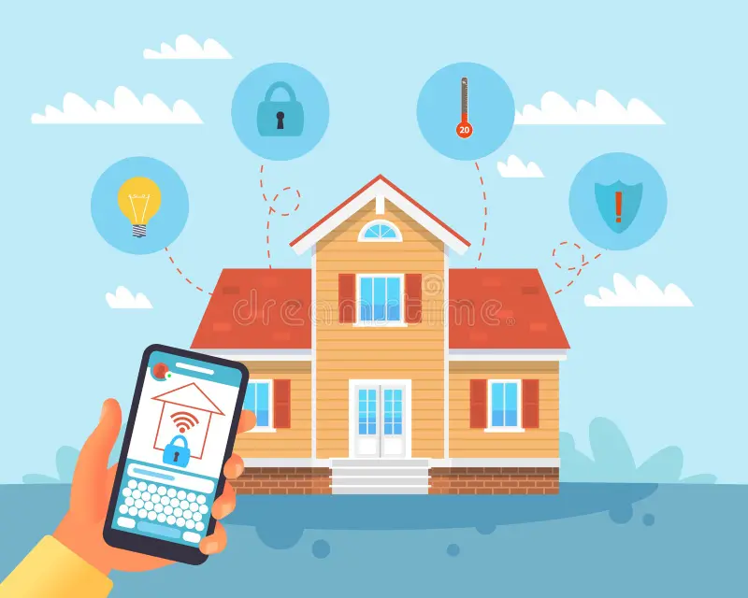
IOT based Home Automation System
ECE 544 and ECE 558 Final Project Group presents…
TEAM MEMBERS: RAKSHA MAIRPADY, RUTUJA MUTTHA, THANUJA BALABASKARAN

Slide 2
Problem Statement:
The primary goal of this project is to design and implement a scalable and efficient home automation system using FPGA technology and an Android application. The system should allow users to remotely control and monitor home appliances, lighting, and other devices through a user-friendly interface.

Slide 3
Features and Functionality:
Initialize the Nexys A7 FPGA board and set up the Control with Android Application (Accomplished successfully )
Establishment of connection between MQTT and ESP32(Accomplished successfully ).
Establishment of connection between ESP32 and FPGA (Accomplished successfully).
Interfacing MPU 6050 sensor to FPGA for temperature measurement .(Accomplished successfully)
Interfacing the FAN to ESP32 which turns when the user turns it on via App.(Accomplished successfully )
Interfacing Stepper_motor_one, to the FPGA which is controlled via ESP32 from the app for Opening/Closing doors of living room.(Accomplished successfully )
Interfacing Stepper_motor_two and Stepper_motor_three to the FPGA which is controlled via ESP32 from the app for Opening/Closing curtains and door of room.(Accomplished successfully)

Slide 4
Features and Functionality:
8.Turning OFF/ON mini bulbs using relay ,installed in different living areas using Android App.
(Accomplished successfully )
9.Controlling the Garage door using Stepper_motor_four. (Accomplished successfully)
10. .Controlling the Garden door using Stepper_motor_five. (Accomplished successfully)
10.Development of a user friendly application in Android studio using navigation control and fragments to create separate pageviews for each living area as designed in the model. (Accomplished successfully).
Stretch functionality:
Setting a Smoke alert using a buzzer and MQ2 - smoke sensor and sending an alert to the user via MQTT where the message gets displayed in the application. (Accomplished successfully).
Controlling the plant watering using a moisture sensor and motor. (Time was not sufficient to accomplish this).

Slide 5
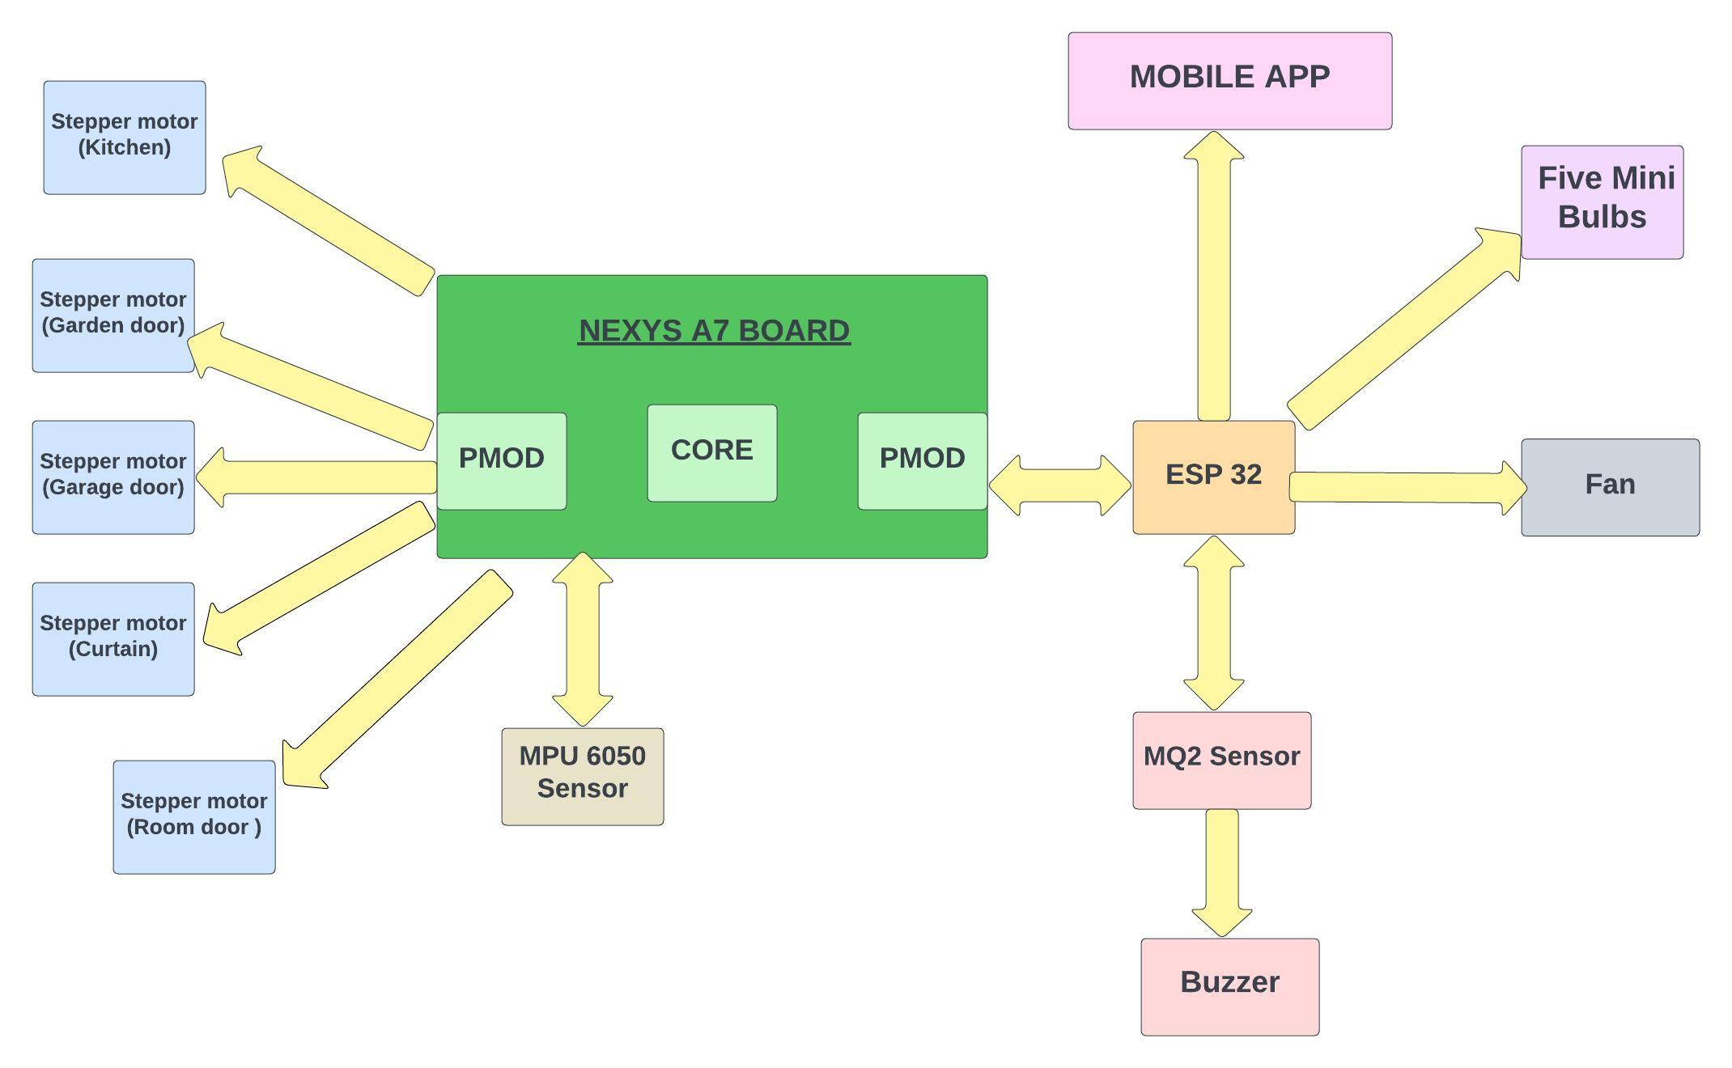
MODEL WORK FLOW :

Slide 6
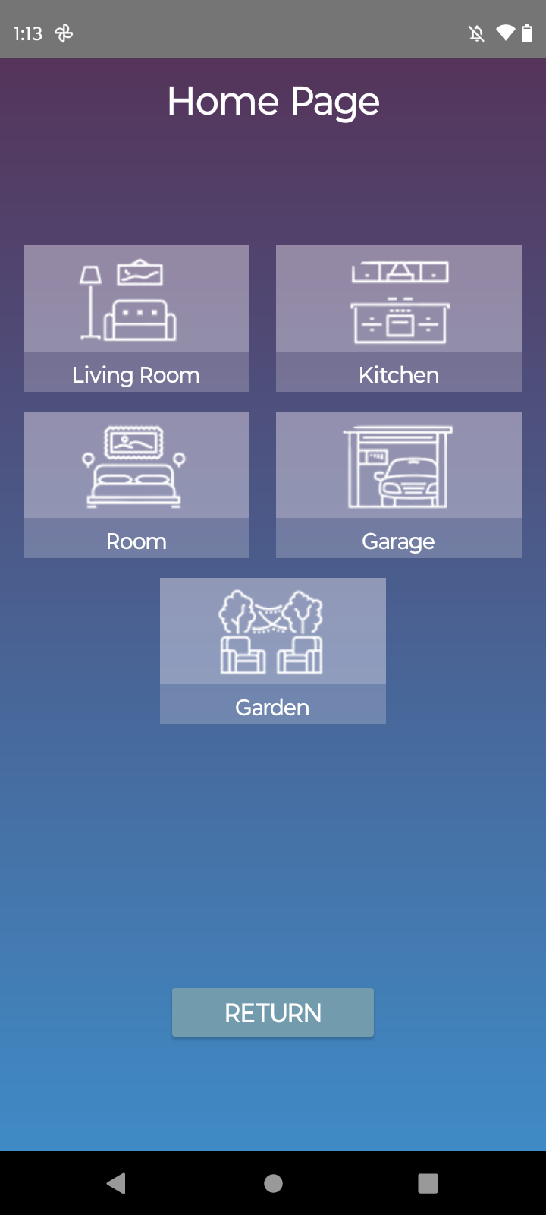
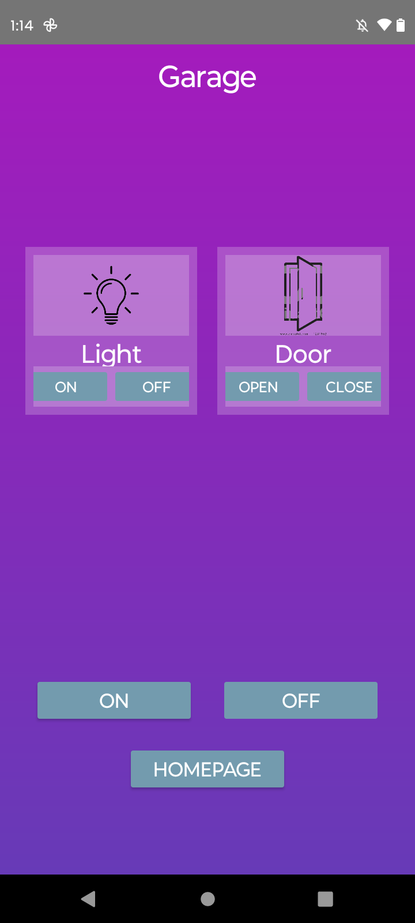
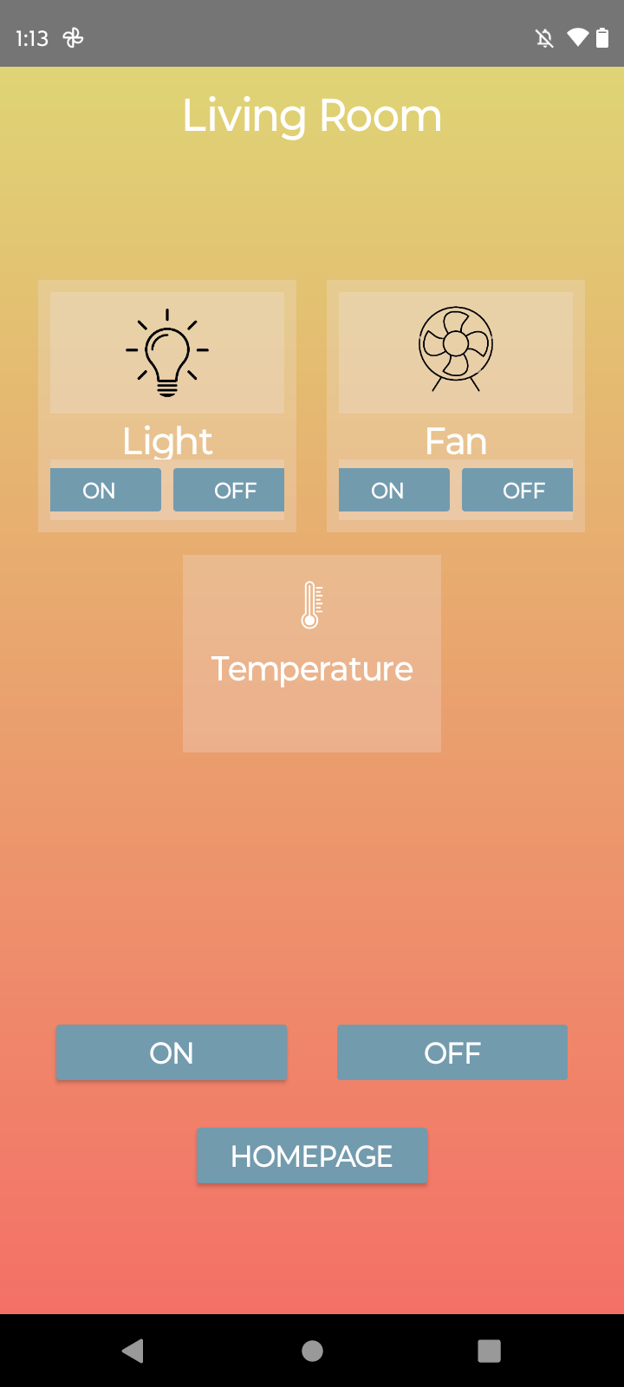
MODEL WORK FLOW :
We've developed an Android application for remote control of various devices. The view pages within the app are designed with colors that match those of the walls in living areas, enhancing user comprehension.

Slide 7
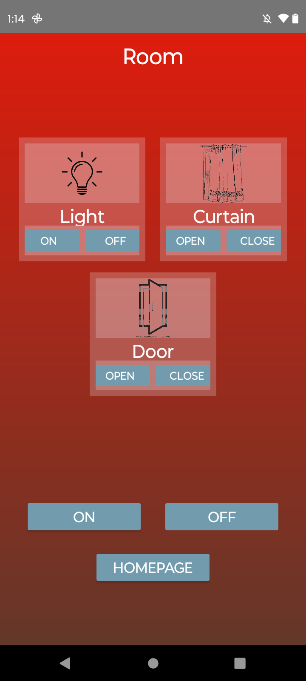
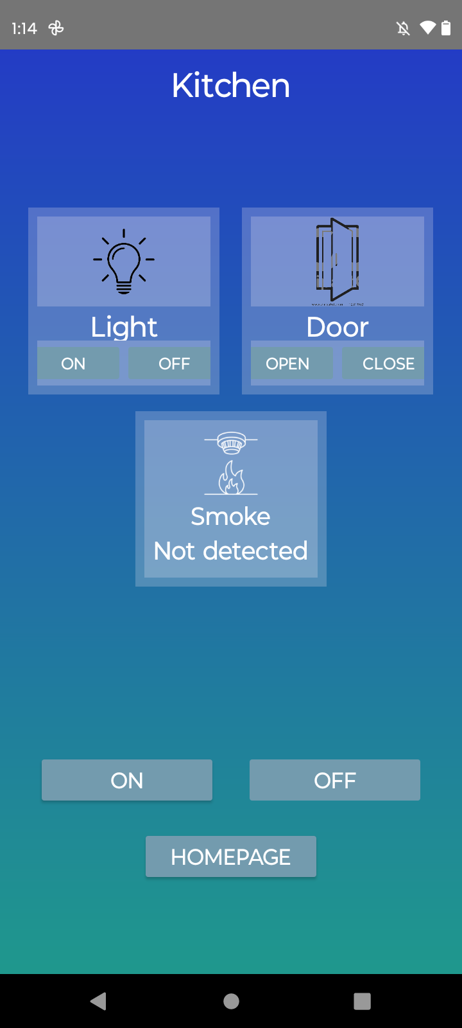
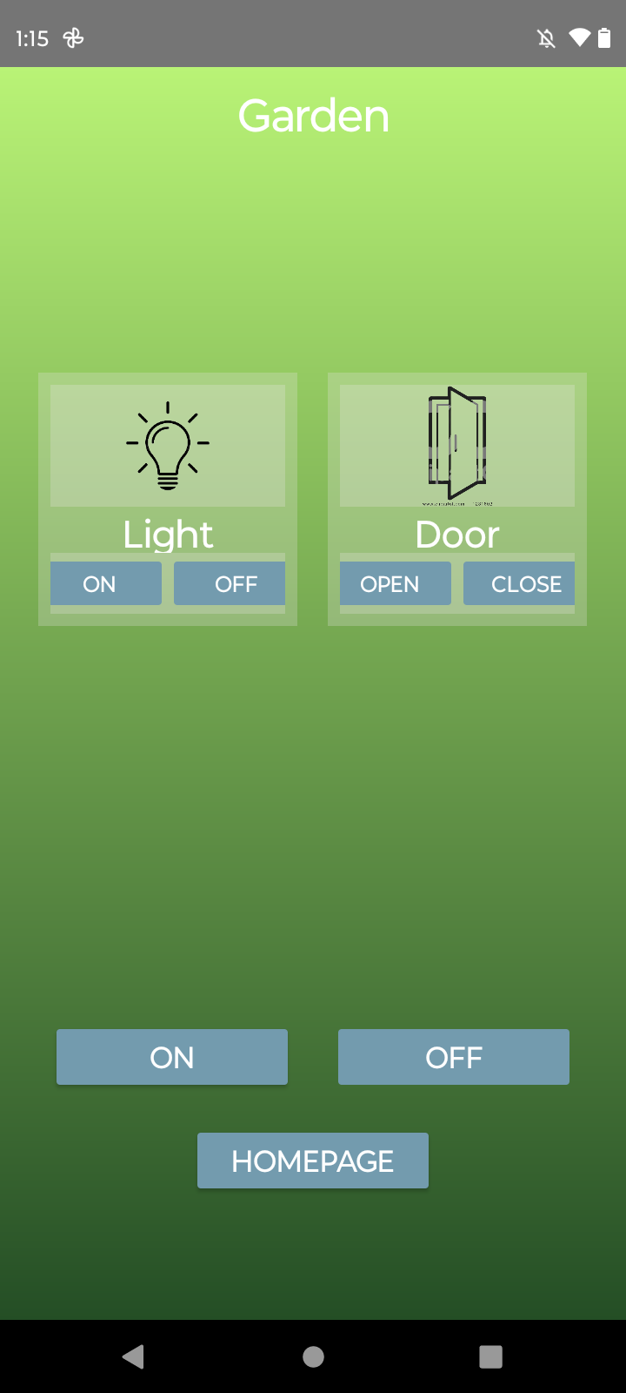
MODEL WORK FLOW :

Slide 8
Division of Labor:
Integration of components ( stepper motor, led , esp 32, fan , sensors) to Nexys A7 by Raksha Mairpady
IP drivers code design for all the sensors and motors by Rutuja Muttha
Android app creation By Thanuja Balabaskaran.

Slide 9
PROBLEMS FACED
Connecting MQTT to different fragments was an issue
Changing the motor speed as per our required design
Integrating everything together
We were hardwiring the pmods which was causing some internal issues .

